Slide 1
Ordination with unifrac distance matrix
With various age, gender subgroups and food tree levels

Slide 2
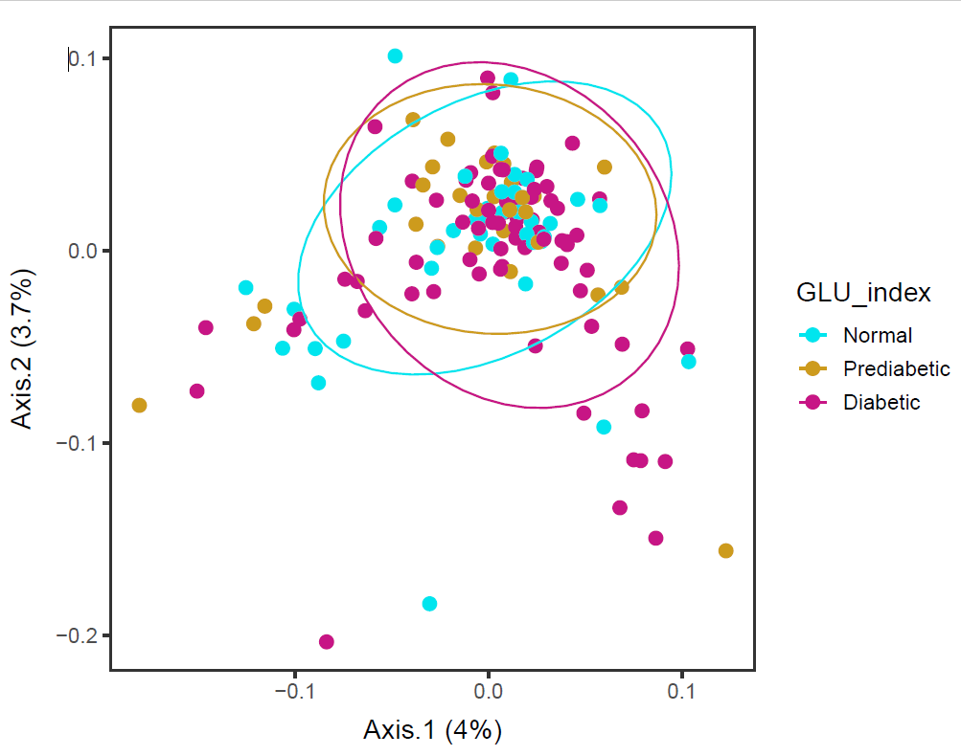
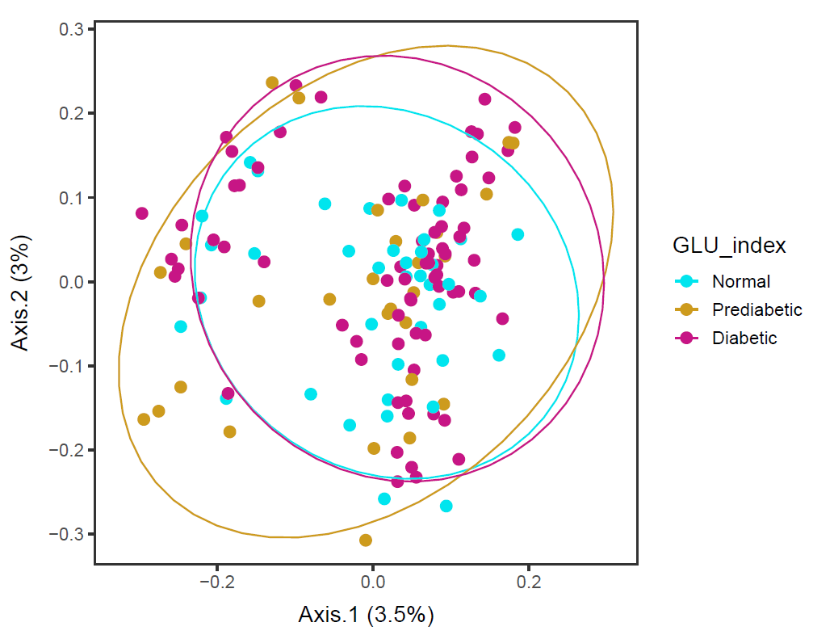
Males in 60s Lv4
Lv4_ord_WEIGHTED
Lv4_ord_UNweighted
vegan::permutest: p-value ~0.18. Assumption OK.
vegan::adonis: p-value 0.05. Groups are borderline different.
vegan::permutest: p-value ~0.27. Assumption OK.
vegan::adonis: p-value 0.05. Groups are borderline different. But in this, Prediabetic looks different from the others.

Slide 3
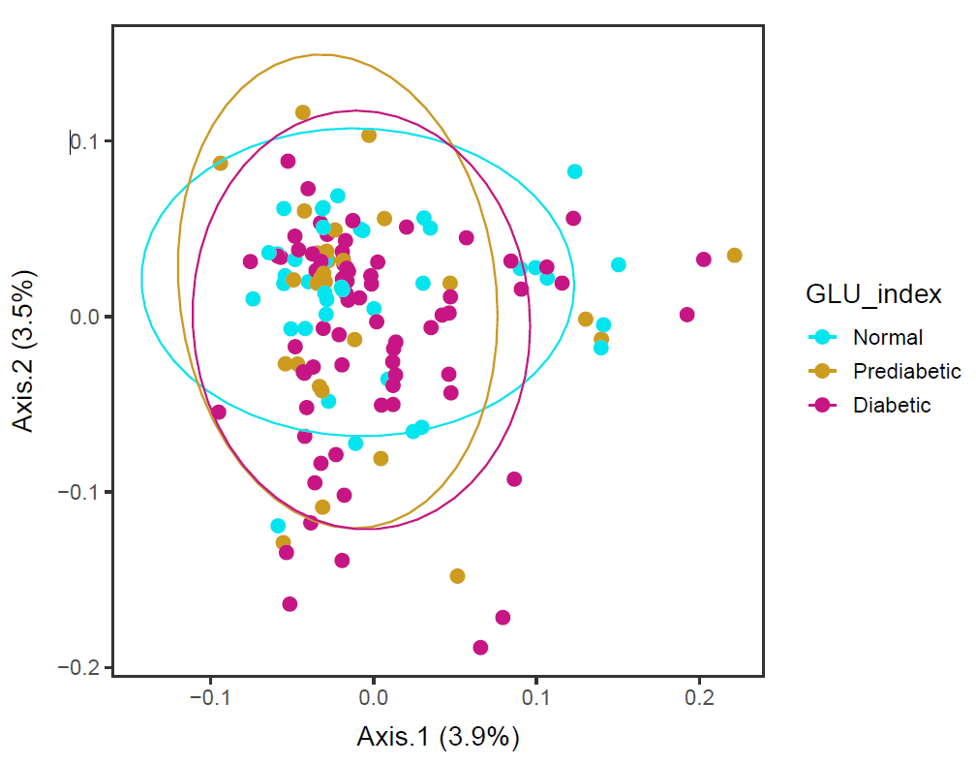
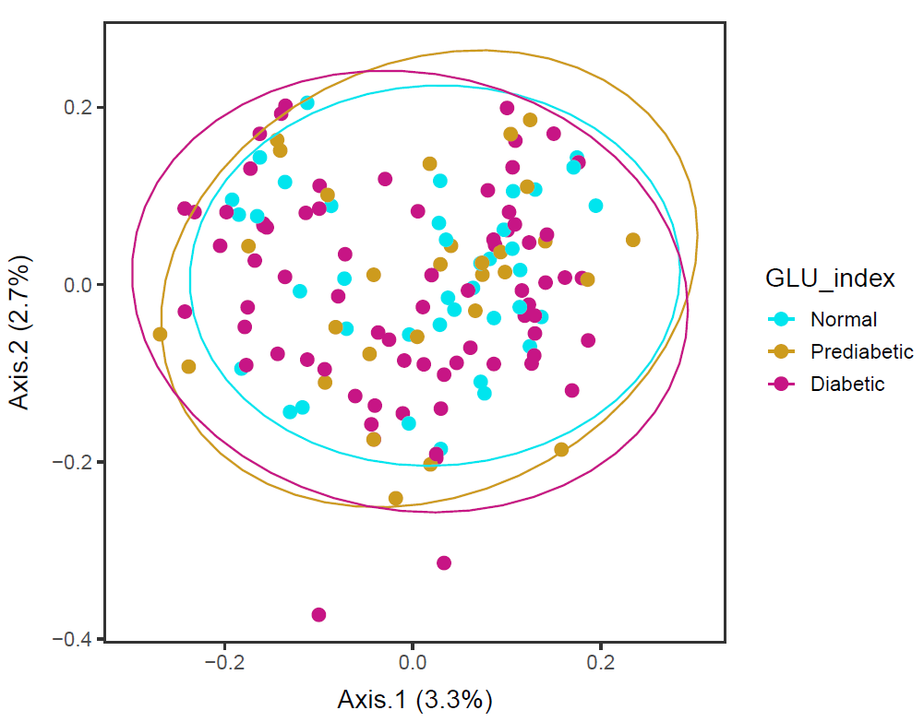
Males in 60s Lv5
Lv5_ord_WEIGHTED, no error in ordination
Lv5_ord_UNweighted
vegan::permutest: p-value ~0.10. Assumption OK.
vegan::adonis: p-value 0.08. Groups are almost borderline different.
vegan::permutest: p-value ~0.50. Assumption OK.
vegan::adonis: p-value 0.05. Groups are borderline different.

Slide 4
Males in 60s Lv4 and Lv5
Ordination results are influenced by
- food tree level and
- whether weighted or unweighted unifrac distance
is used.
But at level 4 and level 5, the three GLU index groups are almost different, while their dispersions are not different.

Slide 5
Males in 60s Lv6
> ordinated_w <- phyloseq::ordinate(phyfoods, method="PCoA", distance="unifrac", weighted=TRUE) # GIVES ERROR...
Error in h(simpleError(msg, call)) :
error in evaluating the argument 'x' in selecting a method for function 'colSums': subscript out of bounds

Slide 6
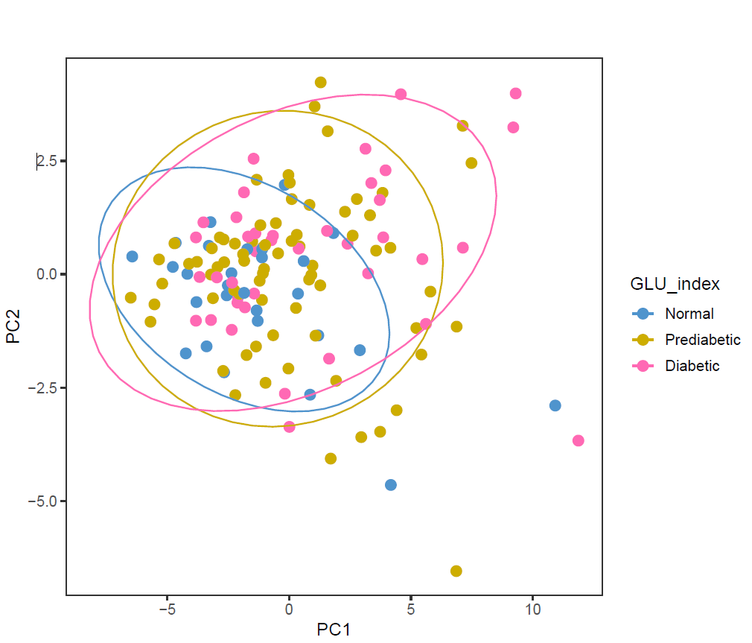
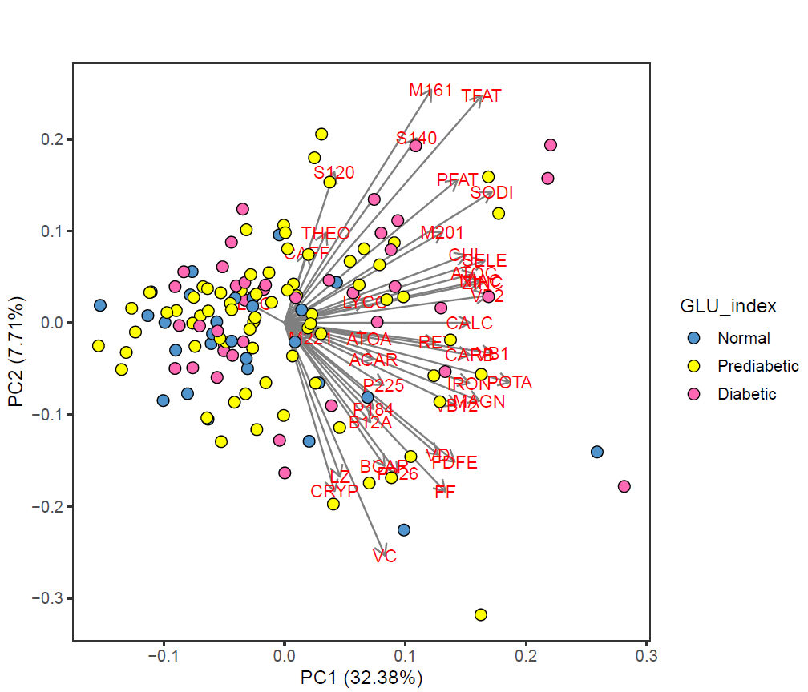
Males in 60s PCA Nutrients

Slide 7
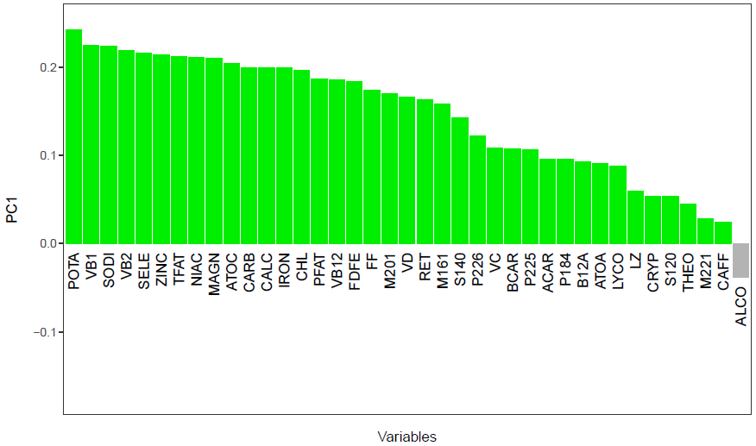
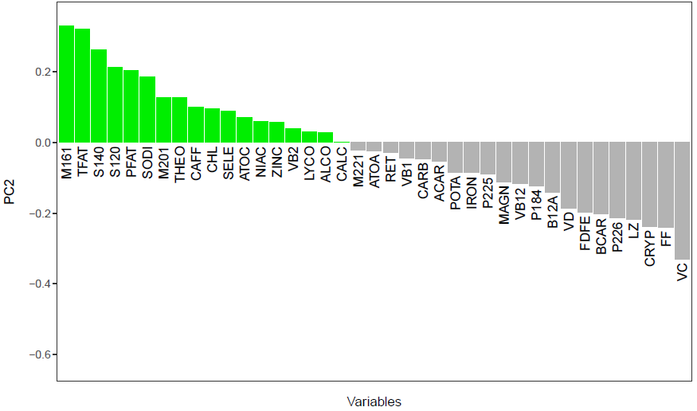
Males in 60s PCA Nutrients

Slide 8
Title

Slide 9
title
HT traits
Textbox
Ag traits

Slide 10
Title

Slide 11
Title
Subtitle

